Slide 1
History and Evolution of EPMagazine
Changes and main steps throughout EPM experience

Slide 2
Aims of the presentation
See past problems and see how they have been solved
Let new problems emerge and find how to solve them
Illustrate history and origin of EPM

Slide 3
Where did I take the data from?
Conference database
Past historical conferences
People who were there

Slide 4
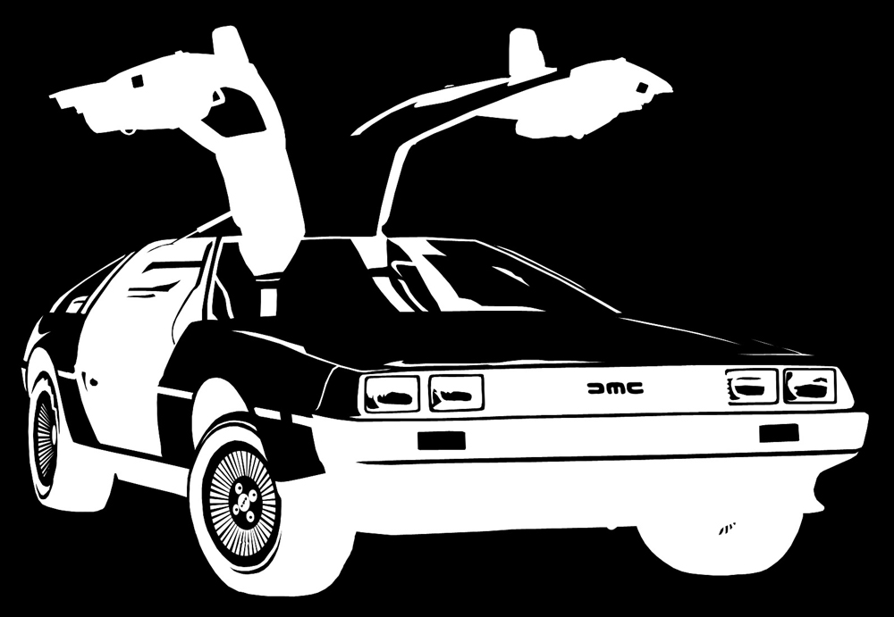
Are you ready for time travel?
Fasten your seatbelts!

Slide 5
EPM: Origins
Hull (U.K.) 2001
HST meeting for teachers. Various project were proposed. EPMagazine is among them.
Waterford (Ireland) 2001
Mr. Rapisarda was called to present the magazine. He could not take part.
Bergen (Norway) 2002
Mr. Rapisarda was called again and presented the project. Two teachers decided to join the project.
Socrates-Comenius 1 2002
The project was approved and mobilities were funded.

Slide 6
Year 2002
Partners: Poland and Austria
Editorial work started by the Italian Team and presented in Kramsach
Contribution Sections: Editorial, General, 13-15 and 16-18
First logo created during Kramsach Meeting jointly by Italians, Austrians and Poles.
The idea of EPM Award was suggested. Not applied until 2004 Kramsach Meeting
How to spread the existence of the magazine (we are still working on this)
Realise the need of ISSN (it was done only in 2004)

Slide 7
Year 2003
The first issue was published in January
The first websites were developed: www.glasfachschule.ac.at/hst (Martin Grindhammer) and www.boggiolera.it/epm (Angelo Rapisarda and Antonino Porto)
Up to 5 issues each year, but this was never done (due to lack of articles) and the huge editorial problems (time of production)
It was decided to publish 2 issues 1st year, 3 issues 2nd year, 5 issues from the 3rd
The idea of the CD was proposed (during the same year a draft version was already available)
Partnership with other magazines was proposed (but never concretised)
Spread the magazine through the web in order to widen its diffusion
The first EPM CD Collection was created

Slide 8
Year 2004
First EPMAward 2003
Assigned to Francesca Cuffaro and others with “Mpemba Effect”.
The prize was a glass prism.
The article was eventually found plagiarized.
EPM Award votes were collected by email
The ISSN was certificated
Austria and Poland left the Project
New partners joined it.
The need of a new official site emerged

Slide 9
Year 2005
Referees’ system was added
A lot of new partners (10 total) joined the project
In the Kayseri Meeting the students’ role in the project was not clear yet. (It wouldn’t become much clearer until later)
EPWAward - the prize would be a flight ticket to the following meeting and the rules became clearer
Aiming to make EPM a valuable tools for pupils’ research in schools
Rick Hilkens proposed to develop the official web site in Landgraaf

Slide 10
Year 2006
EPMagazine.org was created
EPMagazine mirror site developed by Angelo Rapisarda and Antonino Porto
The first issuing lab was started (not implemented as it should)
From.. to conferences were started
Dutch team left the project
The idea of Video-Meeting was proposed

Slide 11
Year 2007
Issues were published on the official website
Tons of talks were (and ARE) not related to the magazine objectives
The idea of using EPM in class was proposed (used?)

Slide 12
Year 2008
Print fewer paper copies in order to reduce expenses
The idea of EPM Blogs was proposed (it has never been used, though)

Slide 13
Year 2009
EPMAward votation via EPMagazine.org
Surveys via EPMagazine.org

Slide 14
Year 2010
Green Energy and University sections were added
Difference between Partners and Editorial Board
Should University and Green Energy section take part in the EPMAward Competition?
The idea of Video-Meeting was re-proposed
The idea of a General Index was proposed

Slide 15
Year 2011
Green energy and University section will not take part in the EPMAward
Problems with financing the EPMAward emerged dramatically
EPMAward was suspended.
Mailchimp was used to send newsletters
Online issuing lab was proposed (in fact not used)

Slide 16
Year 2012
EPM Articles acceptance has been centralized
HST and Green Energy conferences have been officially accepted in the meetings

Slide 17
Conclusions
In the course of time EPM has deeply evolved, but some major problems still remain unsolved:
Magazine distribution
Use in class
Few contributions
Budget
Let us try to make the best of the great job we have been doing so far, improving what is still improvable so as students might learn from their own efforts.

Slide 18
Thank you for your attention
Don’t forget to unfasten your seatbelts!

